Slide 2
NIGHT
DAY
WELCOME!!
LET’S EXPLORE MY ENGLISH 1st PAPER CLASS
LIGHT
DARK
Notes:
To introduce the learners with two opposite words, the teacher can make the classroom environment bringing different images.

Slide 3
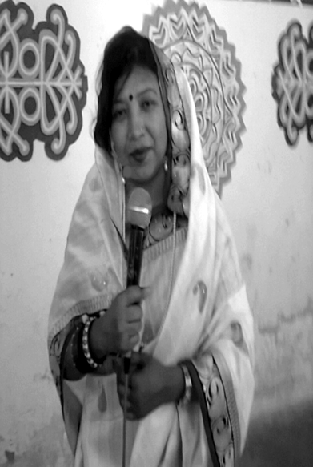
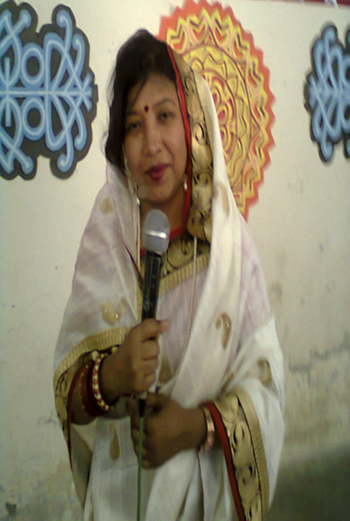
Me
Ismat ara mamataz
Assistant teacher (english)
Dhanmondi govt. Boys’ high school,
dhaka
Notes:
Here I have used 2 black and white and colour pictures to introduce the learners with opposite meaning of a word.

Slide 4
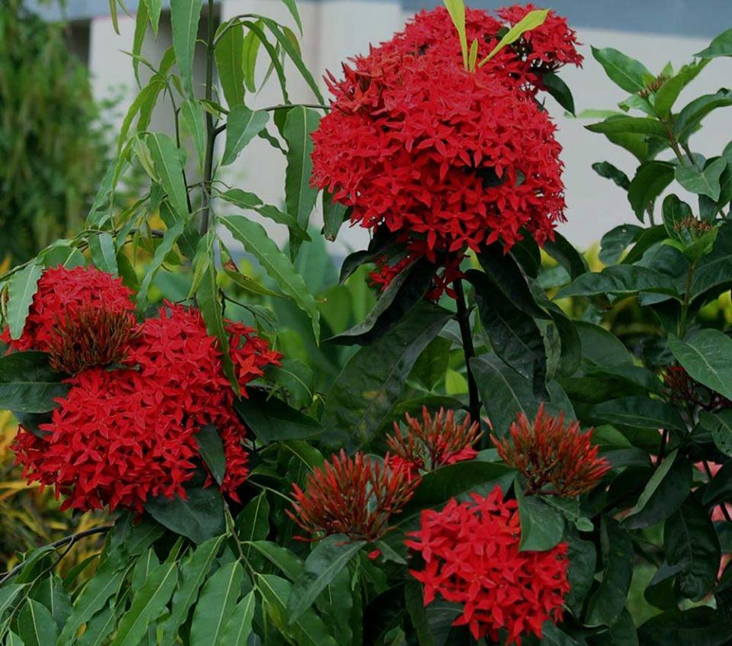
What can you see in the picture ?
A happy and well to do family
Weal
and
woe
come by turns in a family.
Notes:
In the warm up session the teacher can present pictures to give them idea about a word which express the same meaning and an opposite word. Showing the picture the teacher can invite 2/2 students to describe the pictures using the words carrying the same meaning and opposite meaning of the words. After that he/she can go for announcing the day’s topic.

Slide 5
TODAY’s TOPIC
SYNONYMS
AND
ANTONYMS

Slide 6
LEARNING OUTCOMES
By the end of the lesson, the learners will be able to-
ask and answer questions
say what is a synonym and what is an antonym
use synonyms and antonyms in writings

Slide 7
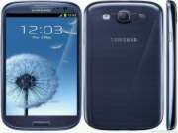
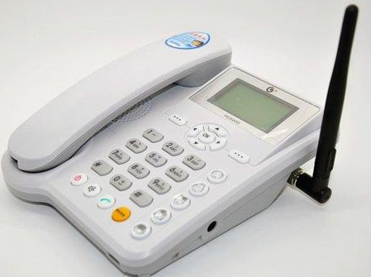
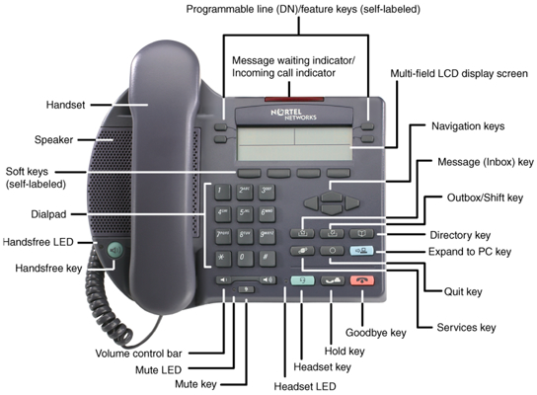
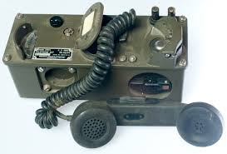
A.Look at the pictures and answer the following questions
a phone set
a phone set
digital
analog
Notes:
The learners will be invited to the board to write sentences with obey and disobey boring and dull.
and

Slide 8
B . Text reading
end
up
finish
begin
start
down
Notes:
The learners will be asked for reading the text
to do the following activities given in the next slides. .

Slide 9
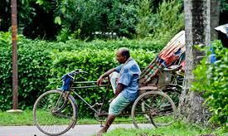
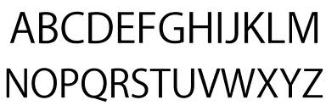
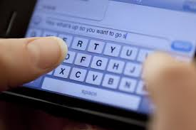
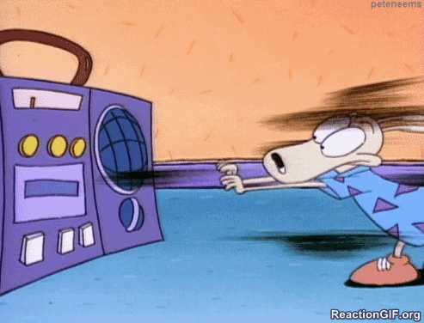
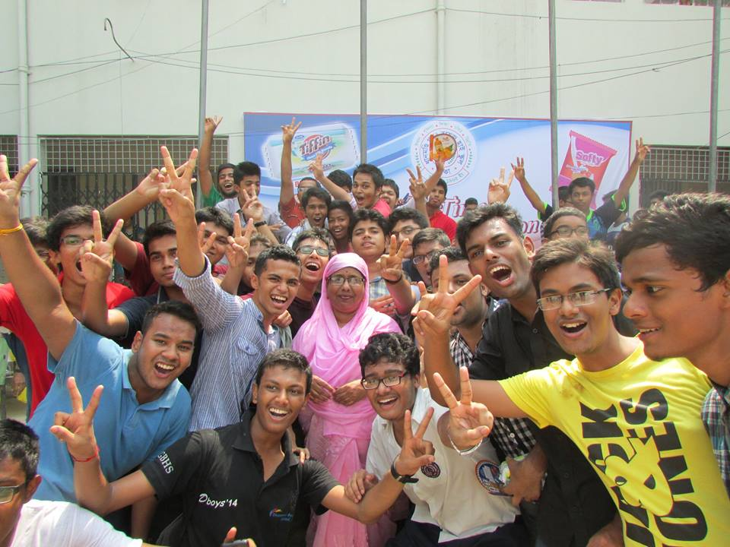
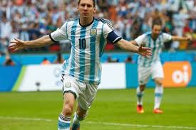
C. Find the synonyms of the following words .Take help of the dictionary. The learners will be asked for looking up the words in the dictionary.
idle ,text , annoyed, result, goal, trip, valuable, return,
Notes:
The teacher

Slide 10
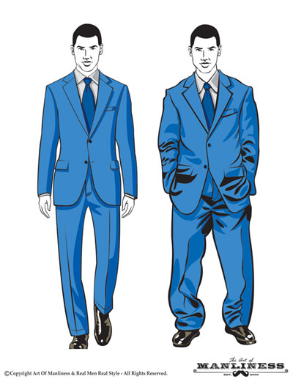
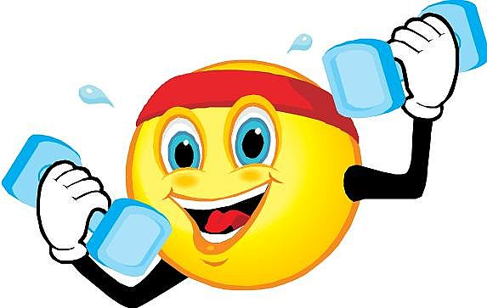
Synonyms
Examples
Word Origin
adjective, fitter, fittest.
1.
adapted or suited; appropriate:
This water isn't fit for drinking. A long-necked giraffe is fit for browsing treetops.
2.
proper or becoming:
fit behavior.
3.
qualified or competent, as for an office or function:
a fit candidate.
4.
prepared or ready:
crops fit for gathering.
5.
in good physical condition; in good health:
He's fit for the race.
6.
Biology.
being adapted to the prevailing conditions and producing offspring that survive to reproductive age.
contributing genetic information to the gene pool of the next generation.
(of a population) maintaining or increasing the group's numbers in the environment.
verb (used with object), fitted or fit, fitting.
7.
to be adapted to or suitable for (a purpose, object, occasion, etc.).
8.
to be proper or becoming for.
9.
to be of the right size or shape for:
The dress fitted her perfectly.
10.
to adjust or make conform:
to fit a ring to the finger.
11.
to make qualified or competent:
qualities that fit one for leadership.
12.
to prepare:
This school fits students for college.
13.
to put with precise placement or adjustment:
He fitted the picture into the frame.
verb (used without object), fitted or fit, fitting.
15.
to be suitable or proper.
16.
to be of the right size or shape, as a garment for the wearer or any object or part for a thing to which it is applied:
The shoes fit.
noun
17.
the manner in which a thing fits:
The fit was perfect.
18.
something that fits:
The coat is a poor fit.
19.
the process of fitting.
Verb phrases
20.
fit out /up, to furnish with supplies, equipment, clothing, furniture, or other requisites; supply; equip:
to fit out an expedition.
Idioms
21.
fit to be tied, Informal. extremely annoyed or angry:
He was fit to be tied when I told him I'd wrecked the car.
22.
fit to kill, Informal. to the limit; exceedingly:
She was dressed up fit to kill.
Origin
Middle English
1325-1375
1325-75; Middle English fitten; akin to Middle Dutch vitten to befit
Related forms
fittable, adjective
unfittable, adjective
Synonyms
1. suitable, apt, corresponding, meet, applicable, apropos. 2. fitting, befitting. 5. healthy, hale, hardy, strong, robust.
Usage note
Both fit and fitted are standard as past tense and past participle of fit 1: The new door fit(or fitted) the old frame perfectly. The suit had fitted (or fit) well last year. Fitted is somewhat more common than fit in the sense “to adjust, make conform”: The tailor fitted the suit with a minimum of fuss.In the passive voice, fitted is the more common past participle: The door was fitted with a new handle.
fit2
[fit]
noun
1.
a sudden, acute attack or manifestation of a disease, especially one marked by convulsions or unconsciousness:
a fit of epilepsy.
2.
an onset, spell, or period of emotion, feeling, inclination, activity, etc.:
a fit of anger; a fit of weeping.
Idioms
3.
by / in fits and starts, at irregular intervals; intermittently: (intransitive) to correspond with the facts or
D , E (PAIR WORK): : Find the synonyms and antonyms of the words in the dictionary page in lesson 3.
fit, fitted, fitting
Check your answers.
verb (used with object), fitted or fit, fitting.
to be adapted to or suitable for (a purpose, object, occasion, etc.).
to be proper or becoming for.
to be of the right size or shape for:
The suit fitted him perfectly.
to adjust or make conform:
to fit a ring to the finger.
to make qualified or competent:
qualities that fit one for leadership
Taking exercise he is making him
qualified/fit for competition.
.

Slide 11
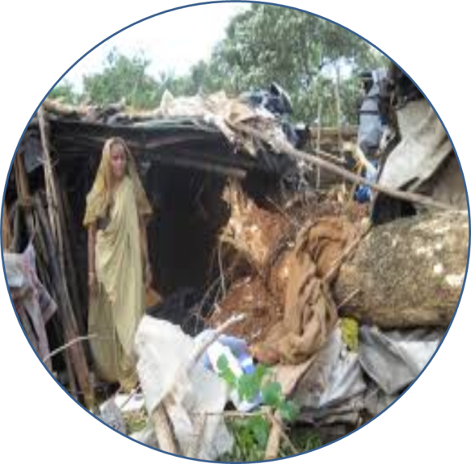
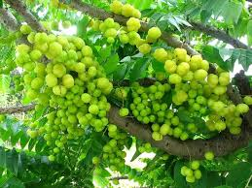
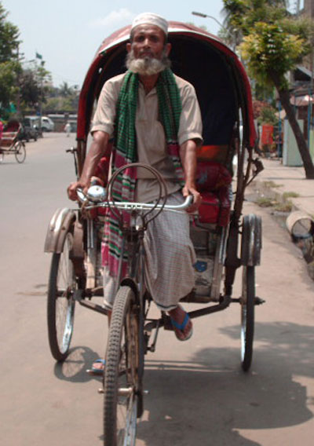
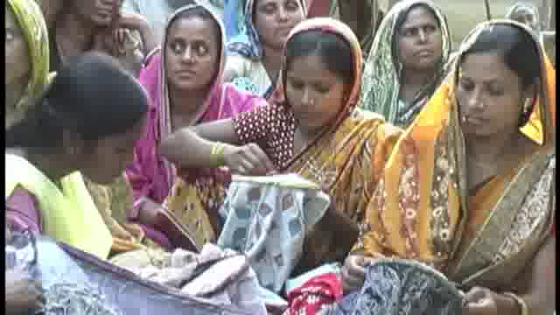
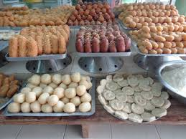
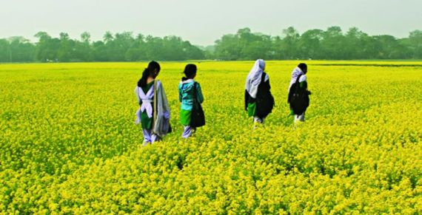
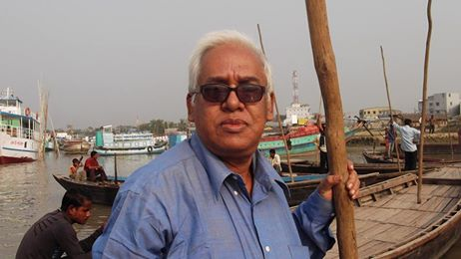
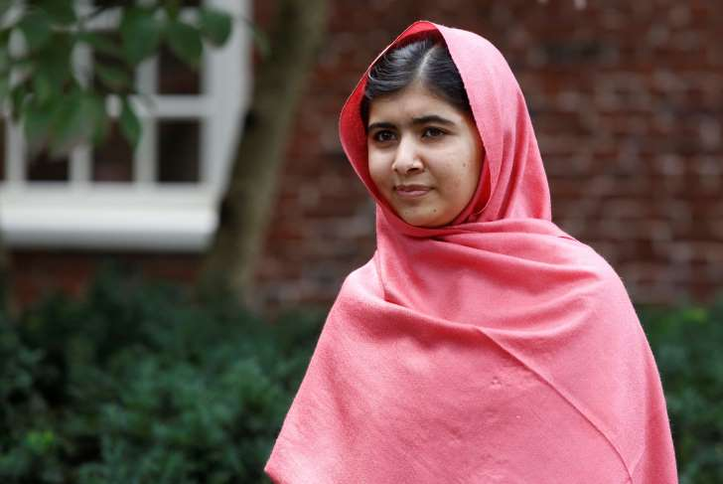
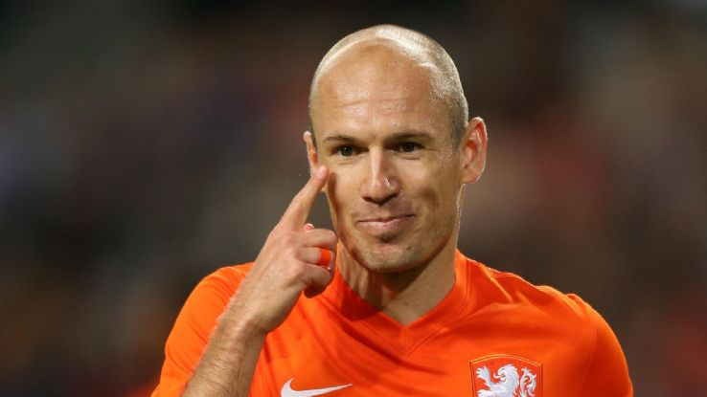
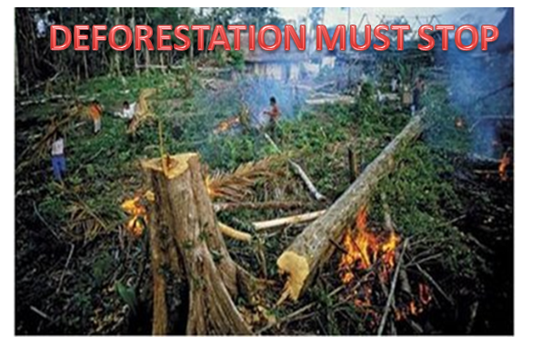
F . From your dictionary find out antonyms
of the following words
complete
unfair
profit
week
soft
sour
strong
sweet
soft
fair
hard
incomplete
loss

Slide 12
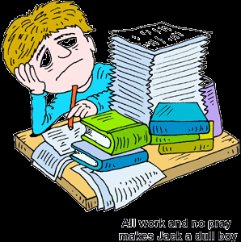
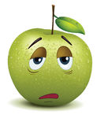
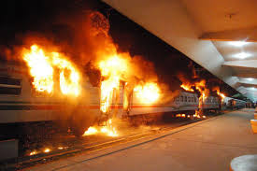
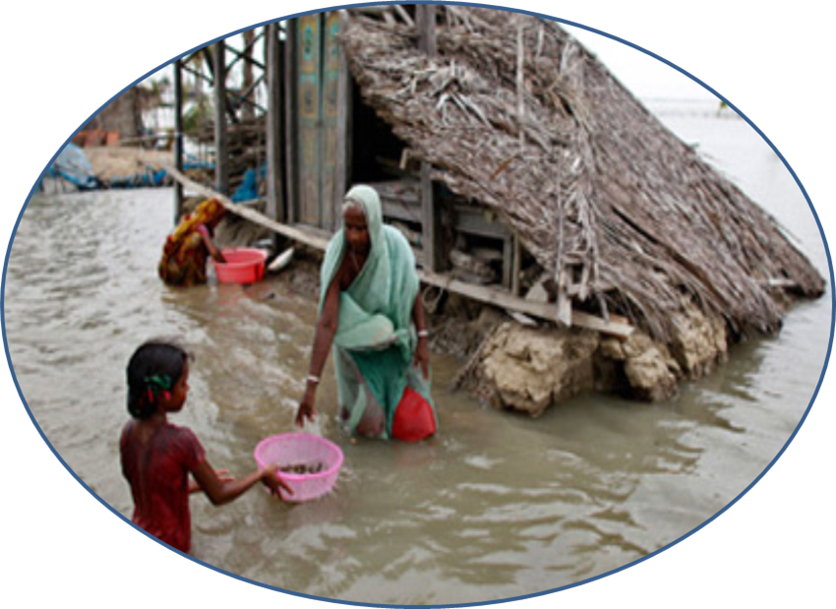
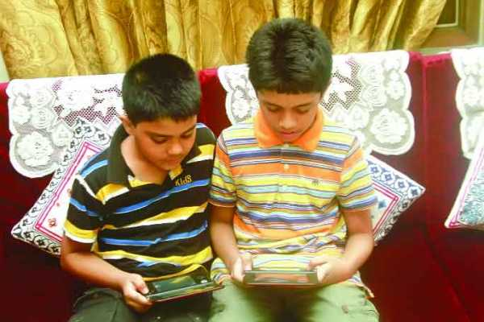
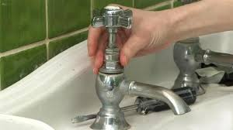
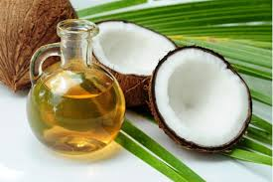
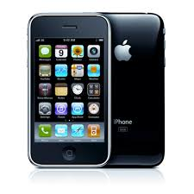
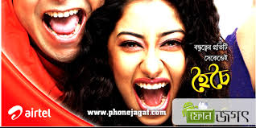
G. Match a word in A with a synonym in B
noise
mend
harm
dull
boring
useful
damage
fix
handy
row

Slide 13
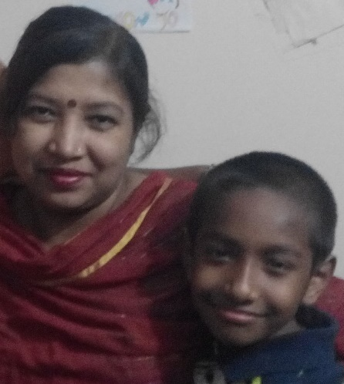
H. Fill in the boxes with
the synonyms of the word ‘happy’
LIVELY
BLISSFUL
HAPPY
JOYOUS
BLESSED

Slide 14
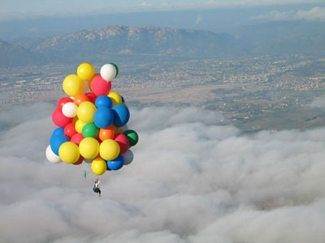
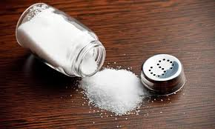
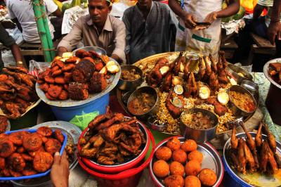
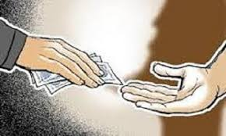
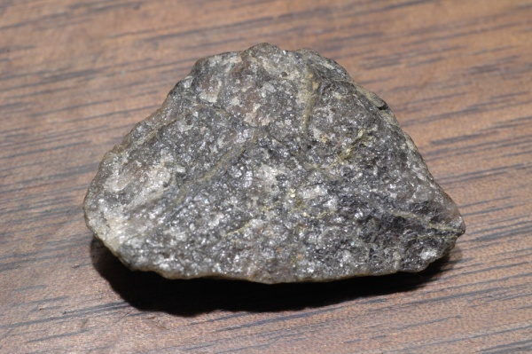
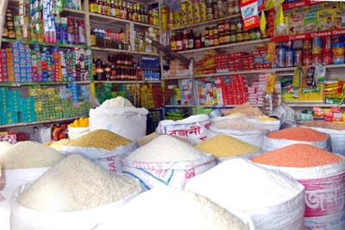
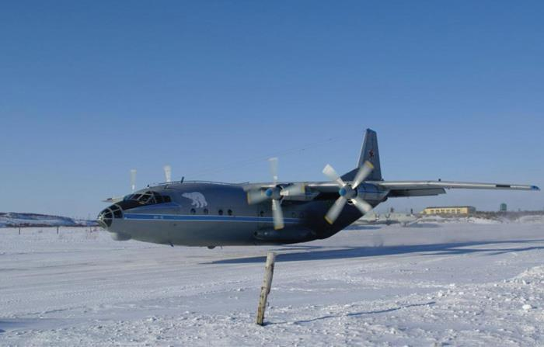
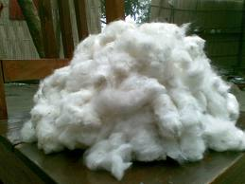
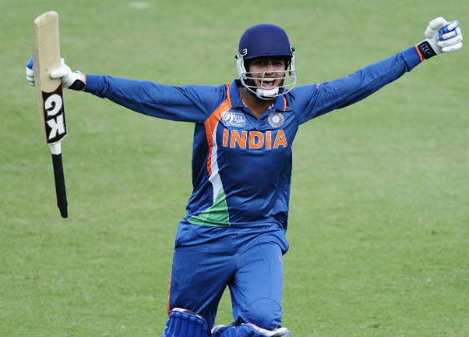
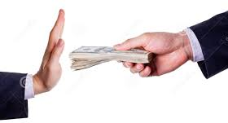
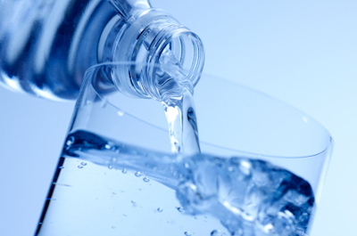
I. Match a word in A with its opposite in B
high
temporary
subtract
accept
heavy
low
permanent
indoor
lose
outdoor
gain
light
add
refuse

Slide 15
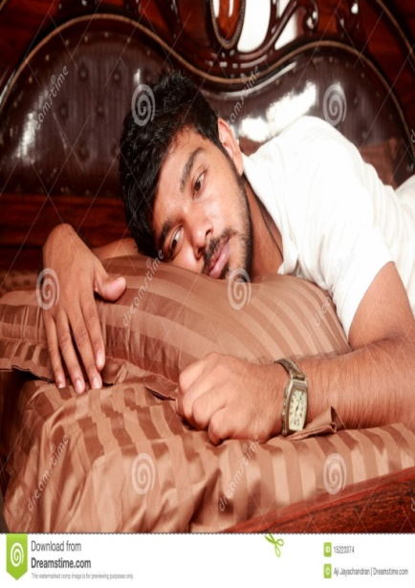
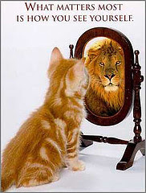
J. Fill in the boxes with the antonyms
of the word ‘happy’
DISAPPOINTED
DEPRESSED
HAPPY
UNHAPPY
DISCOURAGED

Slide 16
Home Work
Writ a paragraph on the basis of the picture
using the following words’ synonyms and antonyms:
meritorious, active, fair play, foul play, good, gentle, win

Slide 17
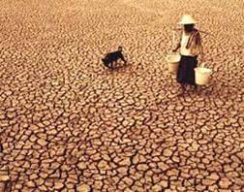
GREY DESERT
GREEN LAND
We want no desert but green forest
THANK YOU SO MUCH

Slide 18
Acknowledgement
MoE, DSHE, NCTB & A2I respective officials
And the editors panel:
Mr. Ranjit Poddar, Associate Prof, TTC, Dhaka,
Mr. Md. Jahangir Hasan, Asst. Prof, TTC, Rangpur,
Urmila Khaled Asst. Prof, TTC, Dhaka.
Their direction, valuable suggestions and intensive supervision have enriched the model contents.

